Slide 1

Trading at close
CHEN Meng
LIANG Tianyi
58340501
58276105

Slide 2

Content
Project Overview
01
Background
Our goal
Realization Stage
02
Preprocessing
Logistic regression
Lightgm
Submission
03
kaggla

Slide 3



Background
The NASDAQ Stock Exchange is a fast-paced, high-risk environment where every second counts, especially in the last ten minutes of the trading day. This period is critical in shaping global economic narratives with intensified fluctuations and rapid price movements.
Overview
Our goal
Predict closing prices using auction and order book data.
Enhance market efficiency in critical trading moments.

Slide 4

Realization Stage
1
Preprocessing
Linear Regression Model
2
3
LightGBM
Let's Get Started

Slide 5
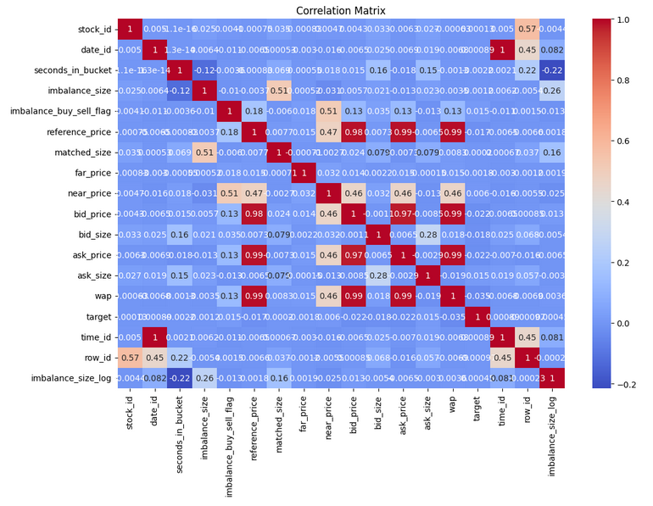
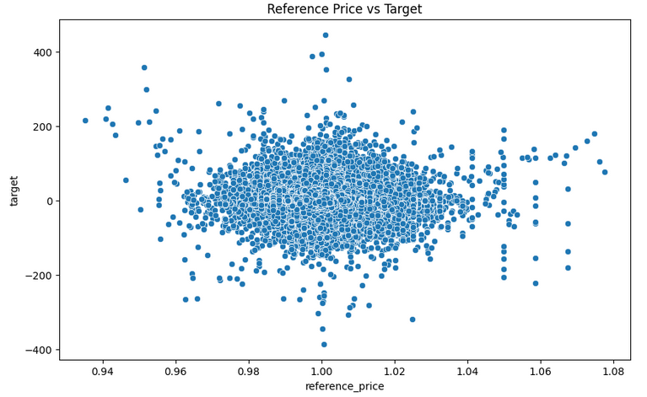
Preprocessing
Data Analysis
Subjective Analysis Based on Experience
Analyzes the 'Imbalance Size' distribution
Correlation Heatmap
Peak Area
Long Tail Distribution
Possible Outliers
High Correlation
Low or No Correlation
Self-correlation
Log-Transformed Imbalance Size
date_id
time_id
row_id
...
far_price/near_price/bid_price/ask_price/wap

Slide 6
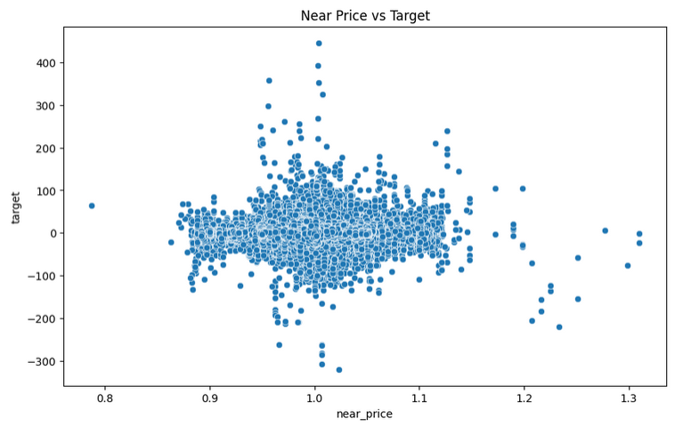
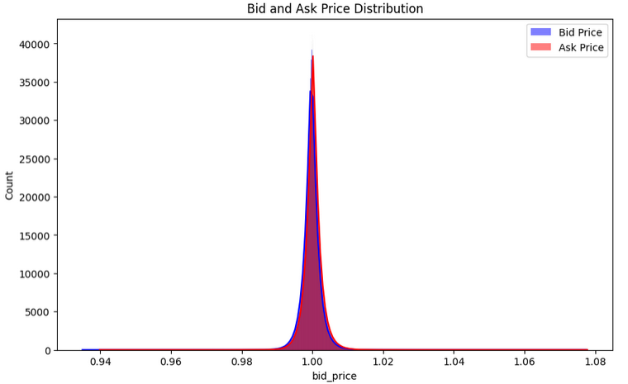
Preprocessing
Feature Engineering
Data Cleaning:
Remove or Impute Missing Values
Handling Outliers
Variable Transformation:
Log Transformation
Standardization
Dimensionality Reduction
Feature Construction:
Price Difference Feature
Interaction Features
Notes:
Data Cleaning:
Remove or Impute Missing Values: If some features have missing values, you can choose to fill them (e.g., using the median) or remove rows containing missing values.
Handling Outliers: For outliers in features like target, imbalance_size, you may choose to truncate them to the 99th percentile, or cap them within a certain range.
Variable Transformation:
Log Transformation: For long-tail distributed features like imbalance_size and matched_size, apply log transformation to reduce the impact of extreme values.
Standardization: Standardize all numerical features (Z-score normalization), especially necessary for linear models and distance-based models.
Dimensionality Reduction:
Remove Columns in Training and Validation Sets: Remove 'row_id', 'time_id', 'date_id' columns. These features do not directly contribute to predicting the target or may lead to data leakage.
Feature Construction:
Price Difference Feature: Calculate the difference between ask_price and bid_price as a new feature to capture the market pressure difference between buyers and sellers.
Interaction Features: Consider creating interaction features between imbalance_size and imbalance_buy_sell_flag to integrate these two related pieces of information.

Slide 7
Model Training
Linear Regression Model
Data Splitting:
As only a training dataset was available, the data is split into a training set and a validation set. This approach enables both model training and performance evaluation.
Ridge Regression:
Handling Correlated Features: It manages problems with features that are too closely related in the data.
Preventing Overfitting: It incorporates regularization, which helps in preventing the model from overfitting.
Enhanced Robustness and Generalization: The model becomes more robust and its ability to generalize on unseen data improves.
Model Optimization and Evaluation
A 5-fold cross-validated grid search was used to find the optimal parameters.
The best model is then used to make predictions on the validation set, and its performance is evaluated by mean square error (MSE), providing a quantitative measure of prediction accuracy.
3
Notes:
Multicollinearity Handling: Ridge Regression effectively addresses issues of multicollinearity in data features.
Preventing Overfitting: It incorporates regularization, which helps in preventing the model from overfitting.
Enhanced Robustness and Generalization: The model becomes more robust and its ability to generalize on unseen data improves.

Slide 8
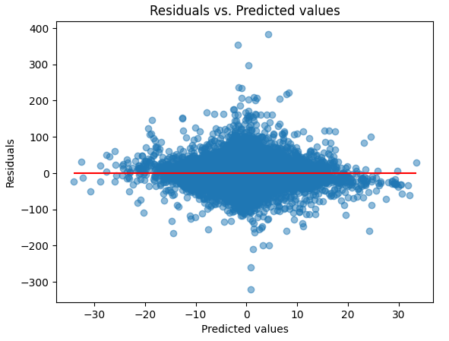
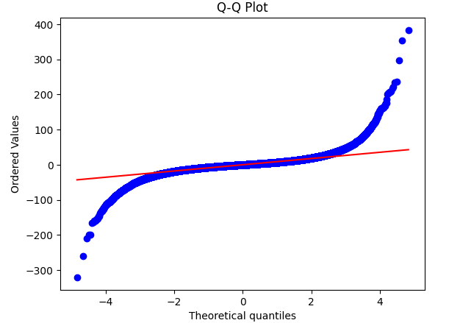
Results Analysis
Q-Q (Quantile-Quantile) plot
The residual plot
The residuals of the model are not completely normally distributed, especially in the extreme values of the data, and the model's performance may deteriorate.
The model's predictive performance is not very stable in those specific regions.
Notes:
The residual plot:Most of the residuals are clustered around the zero line, but there seems to be larger fluctuations in residuals within certain ranges of predicted values. This may indicate that the model's predictive performance is not very stable in those specific regions.
Q-Q (Quantile-Quantile) plot is used to compare the actual distribution of data with a theoretical distribution, typically a normal distribution in regression analysis. This plot is generated by comparing the quantiles of sample data with the quantiles of a theoretical distribution.
In a perfect normal distribution, these points should fall on the red diagonal line, which represents the theoretical distribution. The points shown in the plot deviate from this line, especially at both ends, indicating that the data distribution has heavy tails and does not follow a perfect normal distribution.
Interpreting the shape of the Q-Q plot:
If the data points are mainly near the line (the red line), it suggests that the data distribution is close to a normal distribution.
If the data points deviate from the line at both ends, especially at the extreme quantiles, it indicates that the data distribution has heavy tails, implying the presence of many outliers or extreme variations.
In your Q-Q plot, the data points are relatively close to the line in the middle quantiles but deviate noticeably at both ends, indicating a heavy-tailed distribution. This suggests that the residuals of the model are not completely normally distributed, especially in the extreme values of the data, and the model's performance may deteriorate.

Slide 9

Summary
The model may be too simple: It may fail to capture all the relevant information and patterns in the data, leading to patterns in the residuals.
Heteroscedasticity may be present: The distribution of residuals varies with changes in predictions, indicating that the model has different predictive abilities in different regions of the data.
Nonlinear relationships may not have been captured: Linear models may oversimplify and may not adapt well to the actual complexity of the data.
Notes:
Model Summary:
The LightGBM model, while capable of handling complex non-linear relationships within large datasets, may still have issues with overfitting or underfitting, as suggested by the spread of residuals. The model's reliance on particular features such as 'matched_size' suggests it may not generalize well to unseen data where different features could be more informative. Additionally, the limited computing resources for parameter tuning and the preset parameters in the code may not yield the most optimal model configuration.

Slide 10
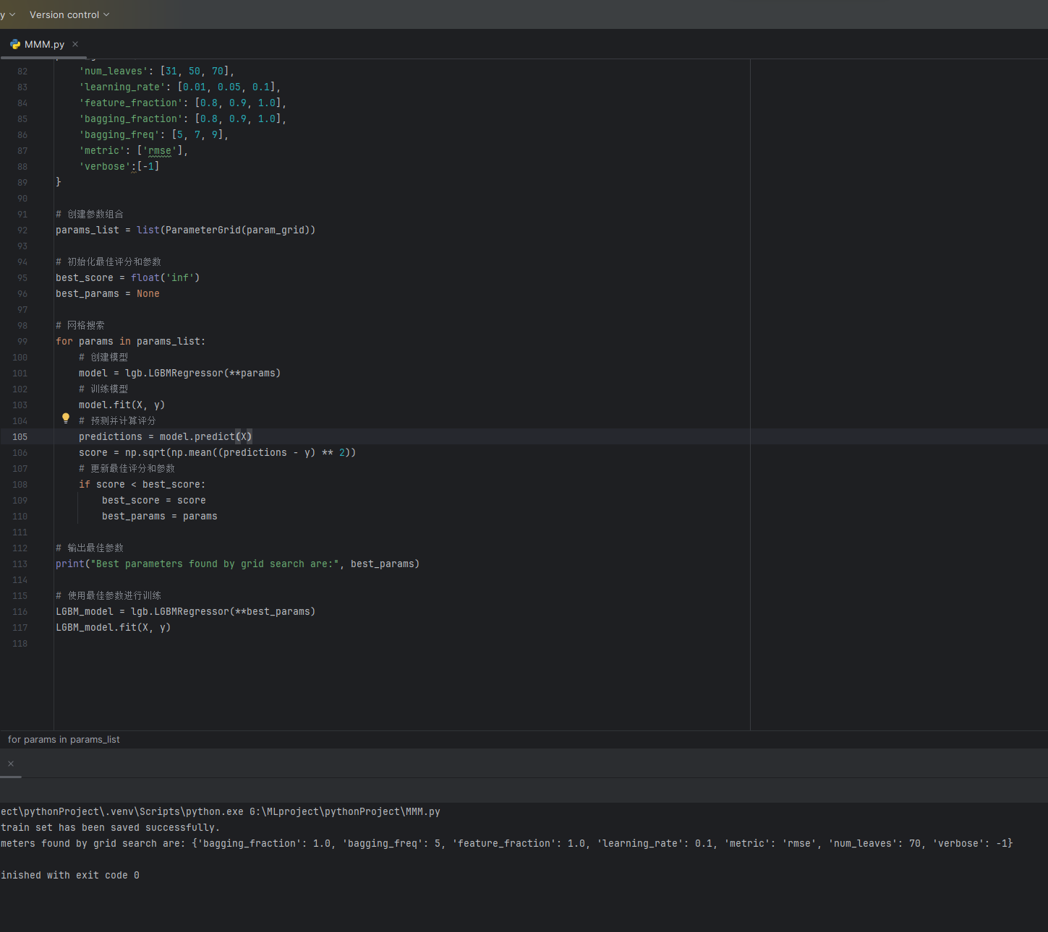
Model Training
LightGBM
Given certain limitations observed in the logistic regression model's predictions
LightGBM:good at handling large-scale data, effectively capturing non-linear relationships, and rapid learning capabilities, making it more apt for complex financial market forecasting
Feature Engineering:
New Features: Introduced features like 'imbalance_ratio', 'imbl_size1', and 'imbl_size2'.
Model Implementation with LightGBM:
Model Optimization: Utilized grid search for optimal parameter selection. Due to limited computing resources, parameter tuning was performed locally for efficiency.
Selected Parameters: The best set of parameters, including 'num_leaves', 'learning_rate', etc., was chosen (refer to picture for details).
3
Notes:
Feature Engineering:
New Features: Introduced features like 'imbalance_ratio', 'imbl_size1', and 'imbl_size2'.
Purpose: These features are designed to capture the dynamics between bid and ask sizes and the overall market imbalance, which are crucial for predicting stock movements.

Slide 11
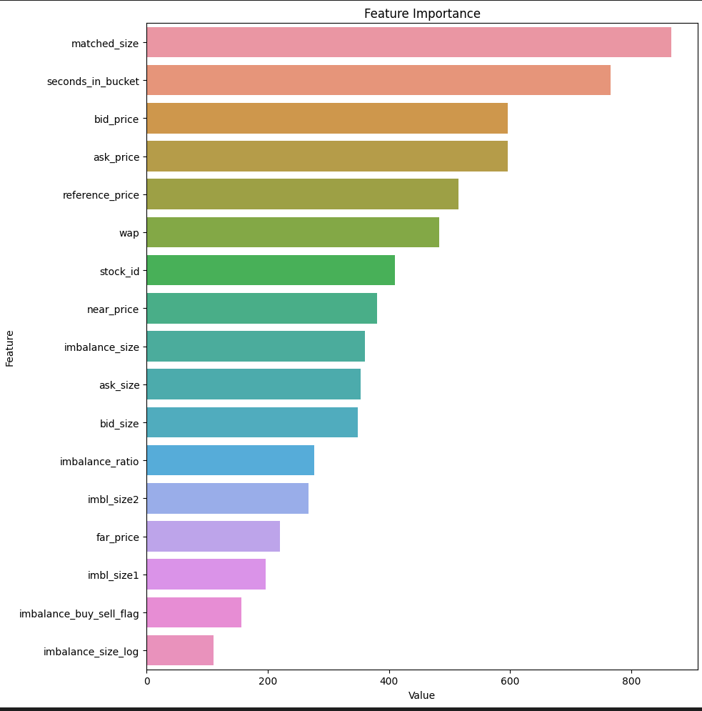
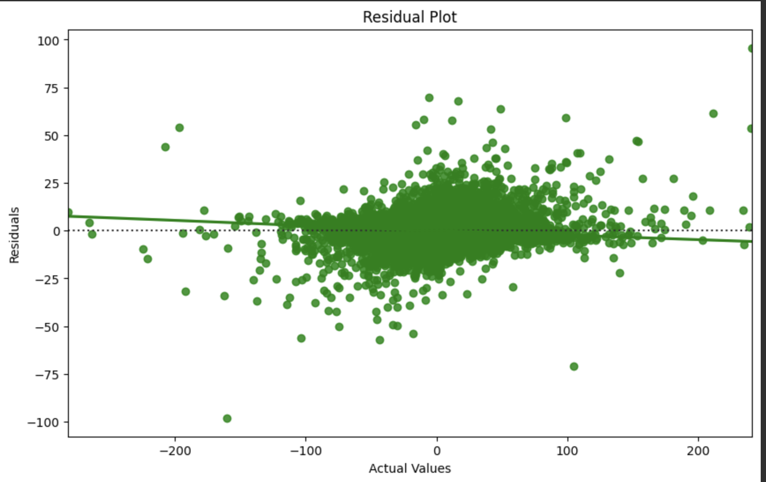
Results Analysis
The residual plot
Feature importance plot
'matched_size' and 'seconds_in_bucket' are the most influential factors for the model's predictions
'imbalance_buy_sell_flag' and 'imbalance_size_log' have the least influence.
Compared with linear regression model, it shows that the prediction accuracy is better.
The distribution of the residual indicates that it may not fully capture all complex patterns in the data
Notes:
LightGBM Residual Plot:
The residuals from the LightGBM model are more centered around zero compared to the linear regression, indicating better prediction accuracy.
However, there is a visible spread of residuals across the actual values, suggesting some degree of model error, possibly from non-linear relationships not fully captured by the model.
Feature Importance Plot Analysis:
The feature importance plot indicates that 'matched_size' and 'seconds_in_bucket' are the most influential factors for the model's predictions, while features like 'imbalance_buy_sell_flag' and 'imbalance_size_log' have the least influence.

Slide 12
Summary
The LightGBM model, while capable of handling complex non-linear relationships within large datasets, may still have issues with overfitting or underfitting, as suggested by the spread of residuals.
The model's reliance on particular features such as 'matched_size' suggests it may not generalize well to unseen data where different features could be more informative.
The lack of k-fold cross-validation during parameter tuning can lead to overfitting, as the model's parameters may be too optimized for a specific training set and not generalize enough to unseen data.
Notes:
Model Summary:
The LightGBM model, while capable of handling complex non-linear relationships within large datasets, may still have issues with overfitting or underfitting, as suggested by the spread of residuals. The model's reliance on particular features such as 'matched_size' suggests it may not generalize well to unseen data where different features could be more informative. Additionally, the limited computing resources for parameter tuning and the preset parameters in the code may not yield the most optimal model configuration.

Slide 13
Submission
1
First-Cut Design Class Diagram
Let's Get Started

Slide 14
Submission
API Initialization: Initialized the competition API to fetch the hidden test set, ensuring it's called only once for the session.
Feature Consistency: Removed features not used in training and filled any missing values to maintain consistency with the training set.
Iterative Prediction: Made predictions on the test set using the best model from the training phase in an iterative manner.
Result Submission: Submitted the predictions to the competition environment to generate the required CSV output.

Slide 15
THANK YOU

